Slide 1
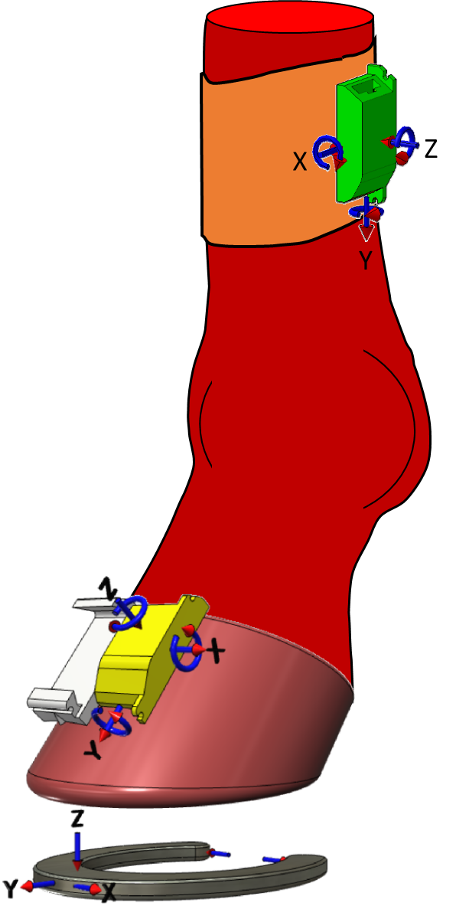
Motion Reconstruction from IMU Measurements

Slide 2
Speed Components
Speed = Strides per second * Stride Length
Stride length = stance length + flight length
Stance length depends on limb geometry

Slide 3
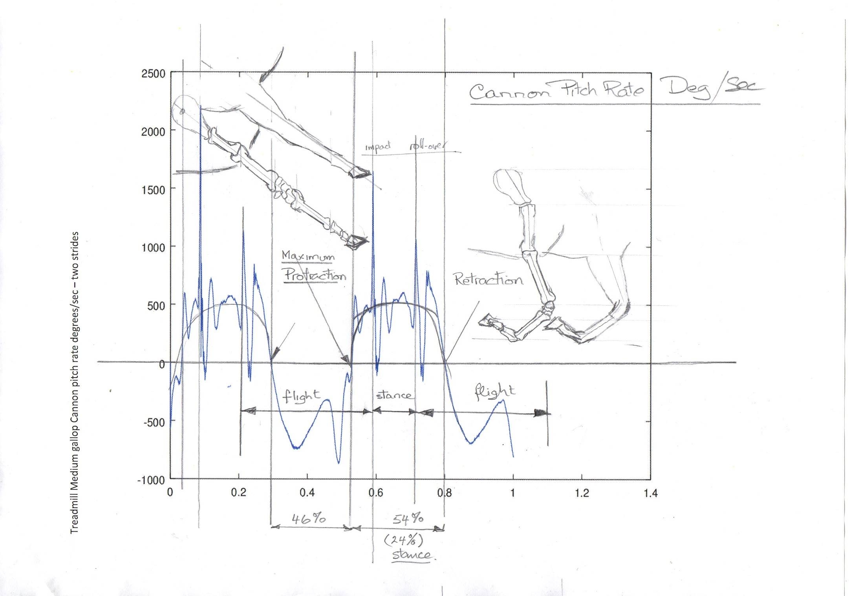
STRIDE ANALYSIS – March 2017
Cannon Pitch Rate Deg/sec
Impact
Roll over
54 %
Maximum protraction
Maximum Retraction
46 %
flight
stance
flight
76 %
24 %
76 %

Slide 4
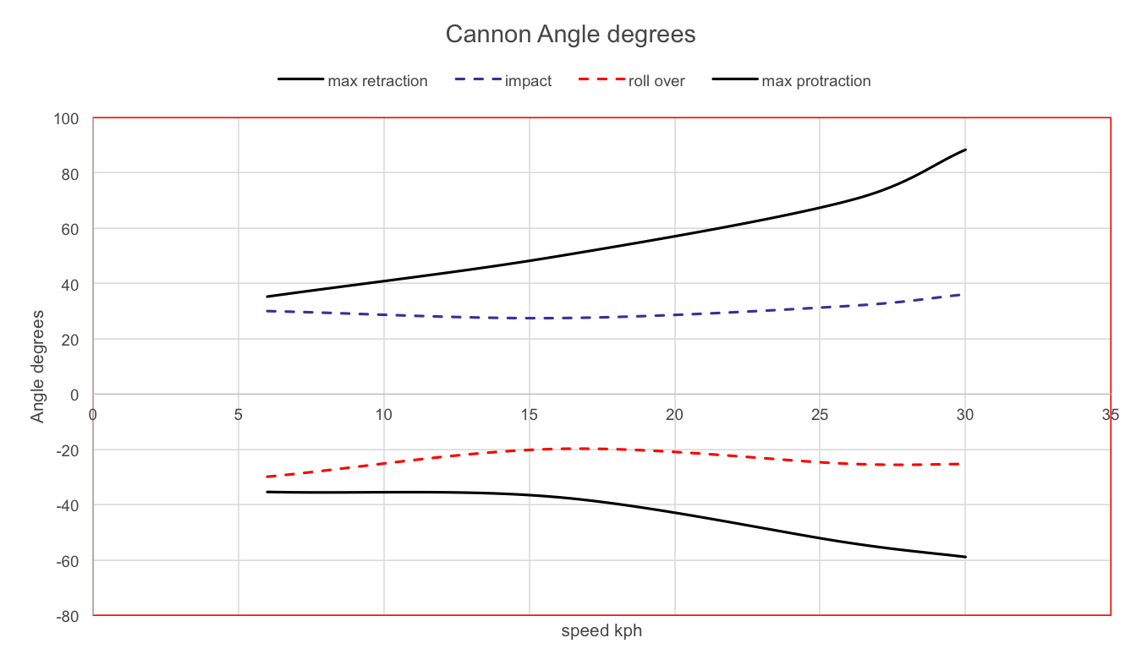
STRIDE ANALYSIS – March 2017

Slide 5
Limb Motion Measurements
Limb Force Estimation
Energy Calculations and Fatigue
Injury and Breakdown
Effect of track surface and training load on fatigue and injury

Slide 6
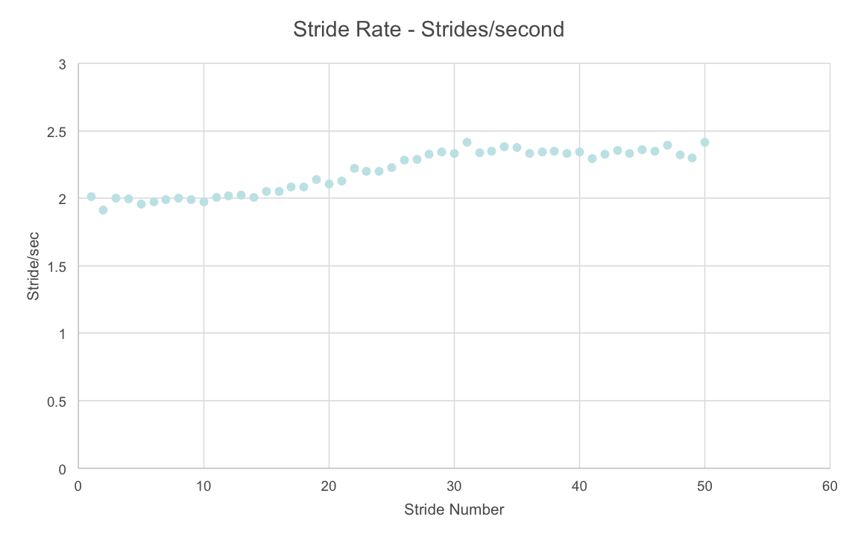
Stride Rate measurements -- Gallop

Slide 7
Motion Reconstruction from IMU Measurements
Using the kinematic equations of motion of a rigid body we are able to reconstruct position and angles from measurements of linear acceleration and angular rate –
-- Providing that we can account for instrumentation errors and can determine all initial conditions

Slide 8
Motion Reconstruction from IMU Measurements
Because time integration is involved then any bias errors in the measured quantities will introduce signal drift in the integrated quantities.
To avoid this problem a sequence of stride measurements are averaged in both time and amplitude to define a “Normalised Average Stride”.
The assumption is made that all quantities at the end of the “ normalised average stride will equal the initial values.

Slide 9
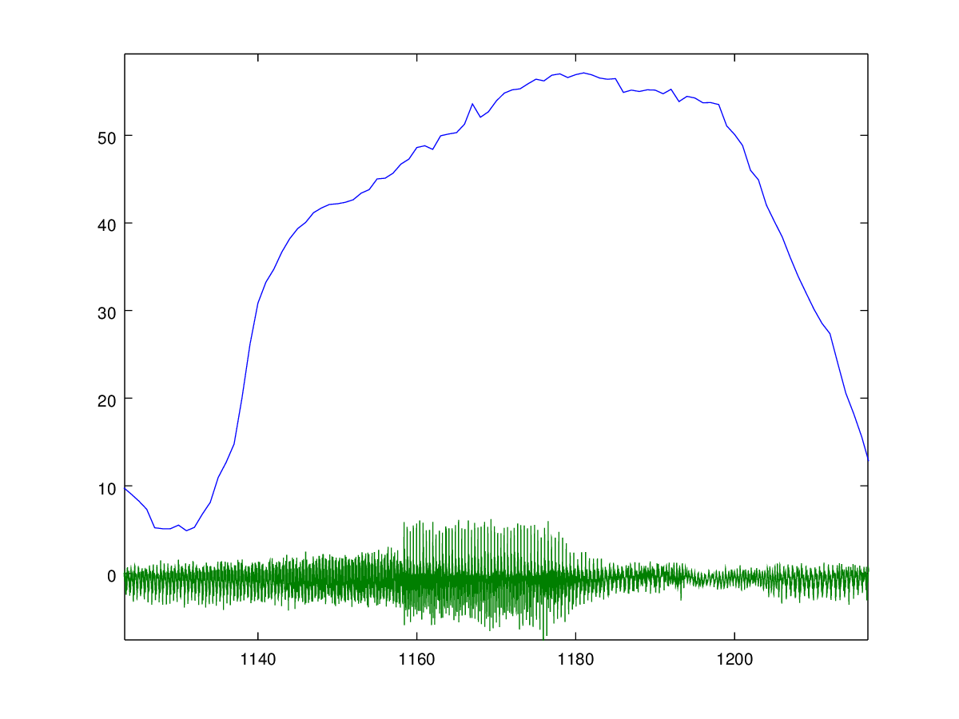
Motion Reconstruction from IMU Measurements
Flynn Cranbourne Grass 11.04.2018
Speed (kph)
AND
Hood Vertical Acceleration (g)
Time steps (100/sec)

Slide 10
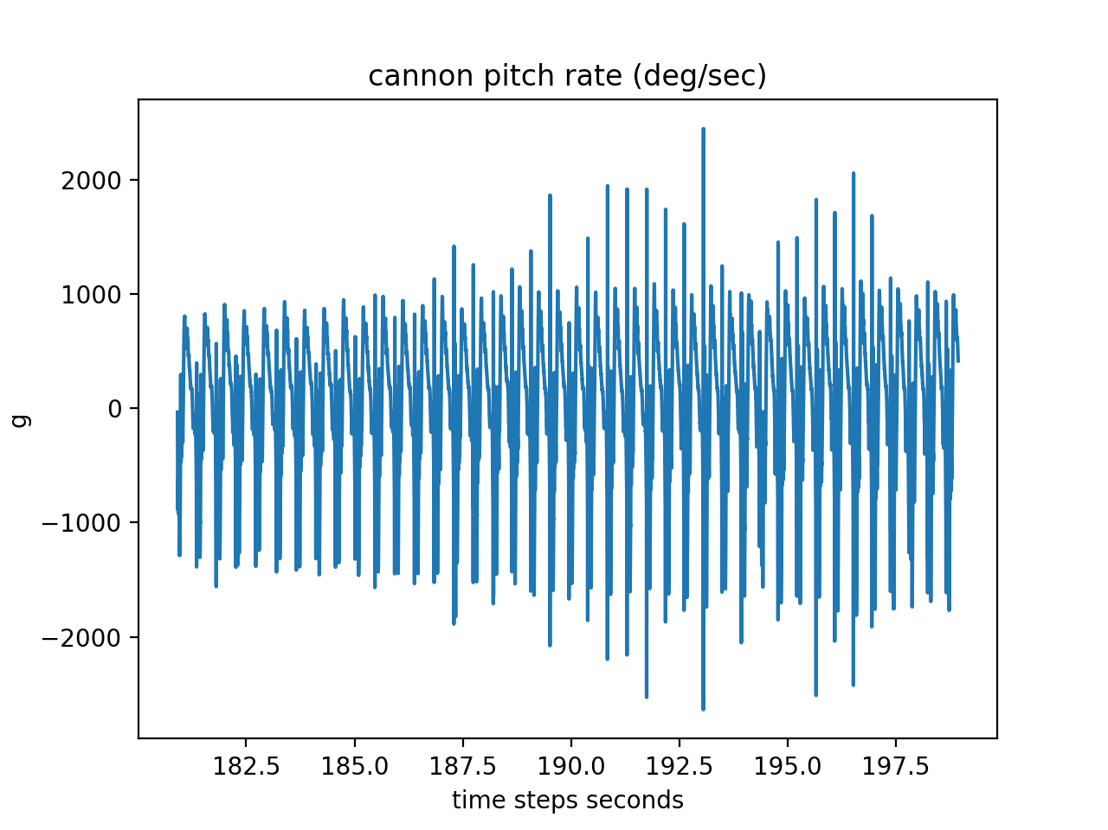
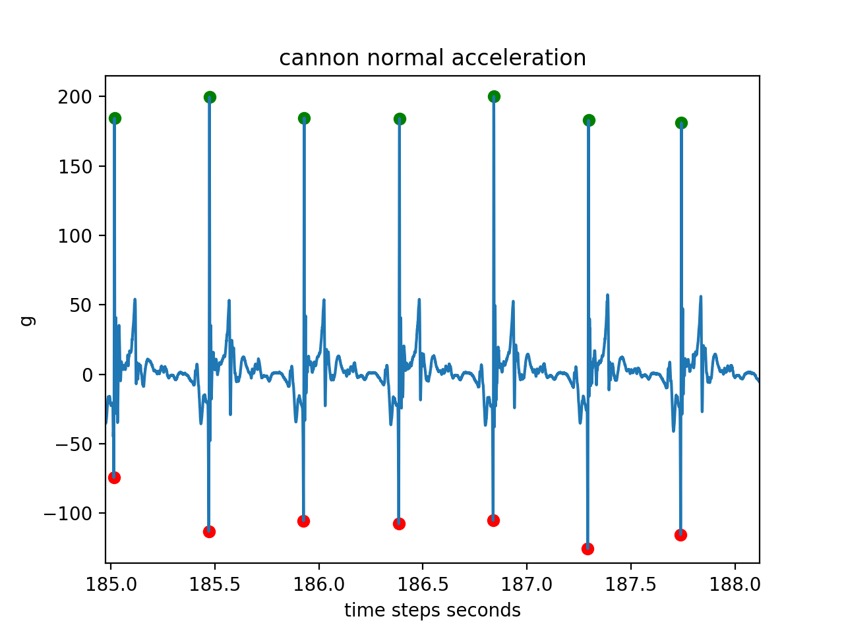
Motion Reconstruction from IMU Measurements
Examples of IMU measurements

Slide 11
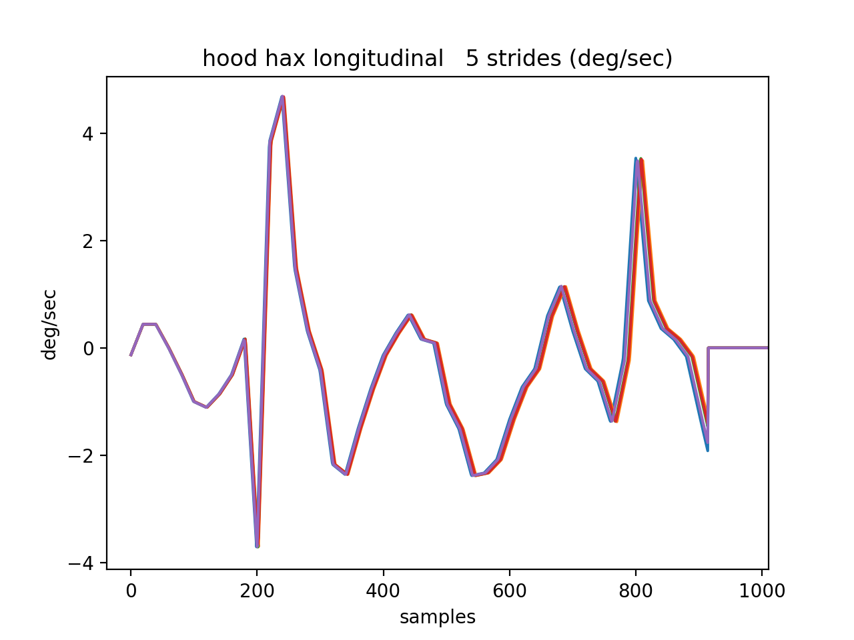
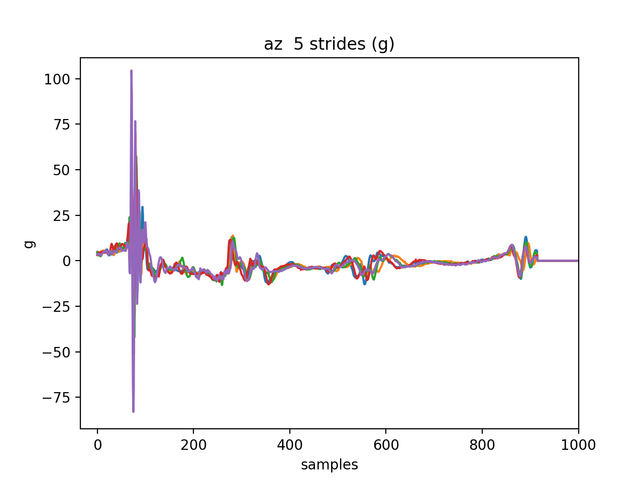
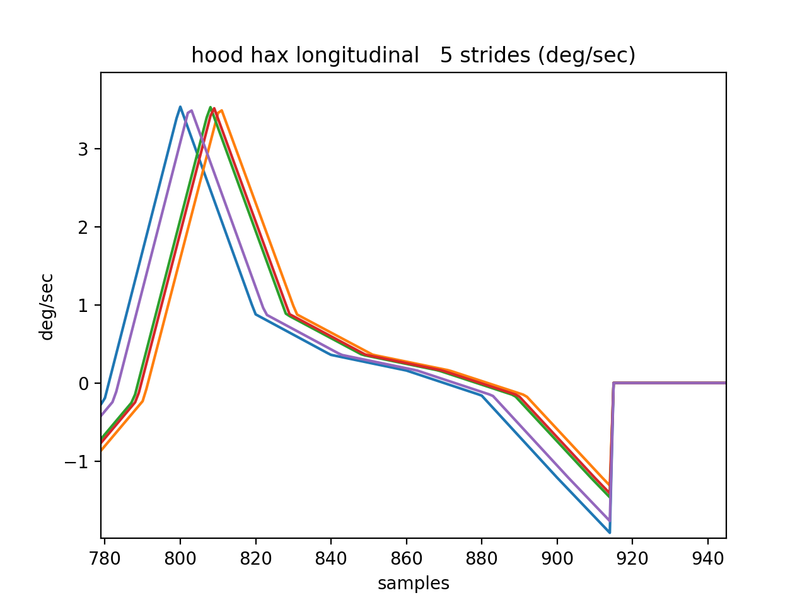
Motion Reconstruction from IMU Measurements
Cannon data for 5 selected strides
Hood data for 5 selected strides

Slide 12
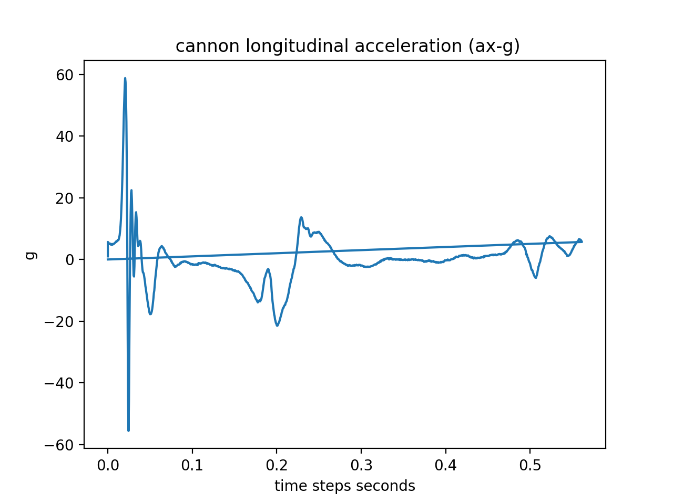
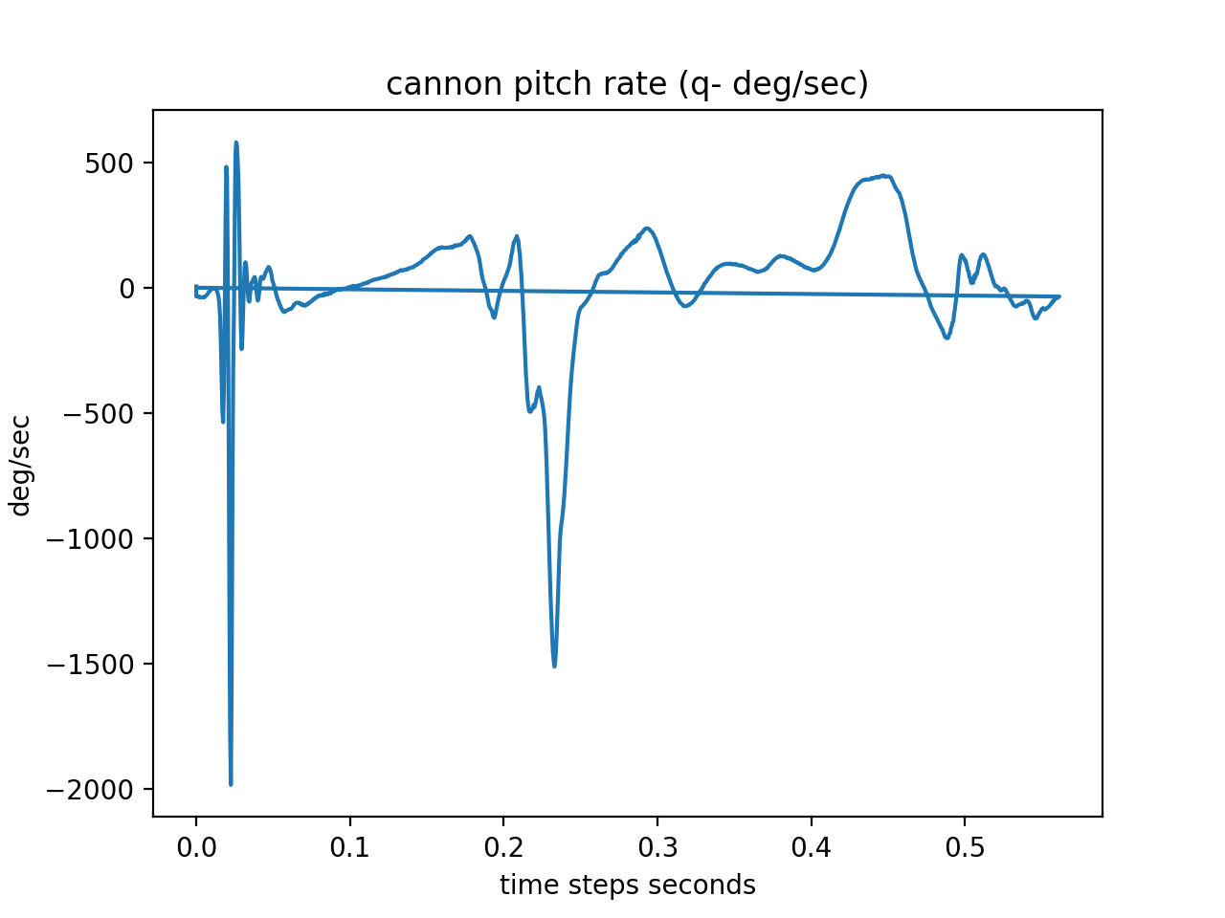
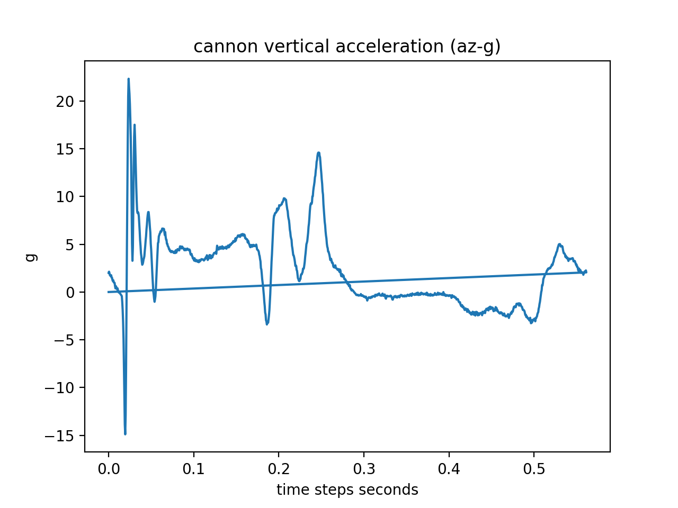
Motion Reconstruction from IMU Measurements
Normalised Average Stride Data

Slide 13
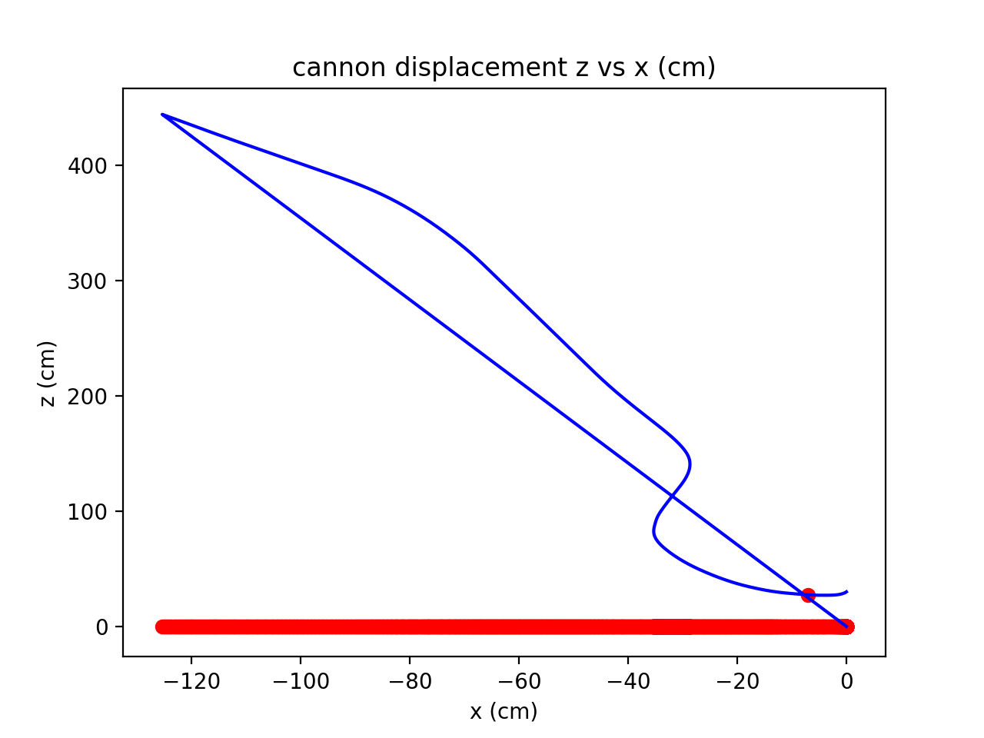
Motion Reconstruction from IMU Measurements
Iteration 1

Slide 14
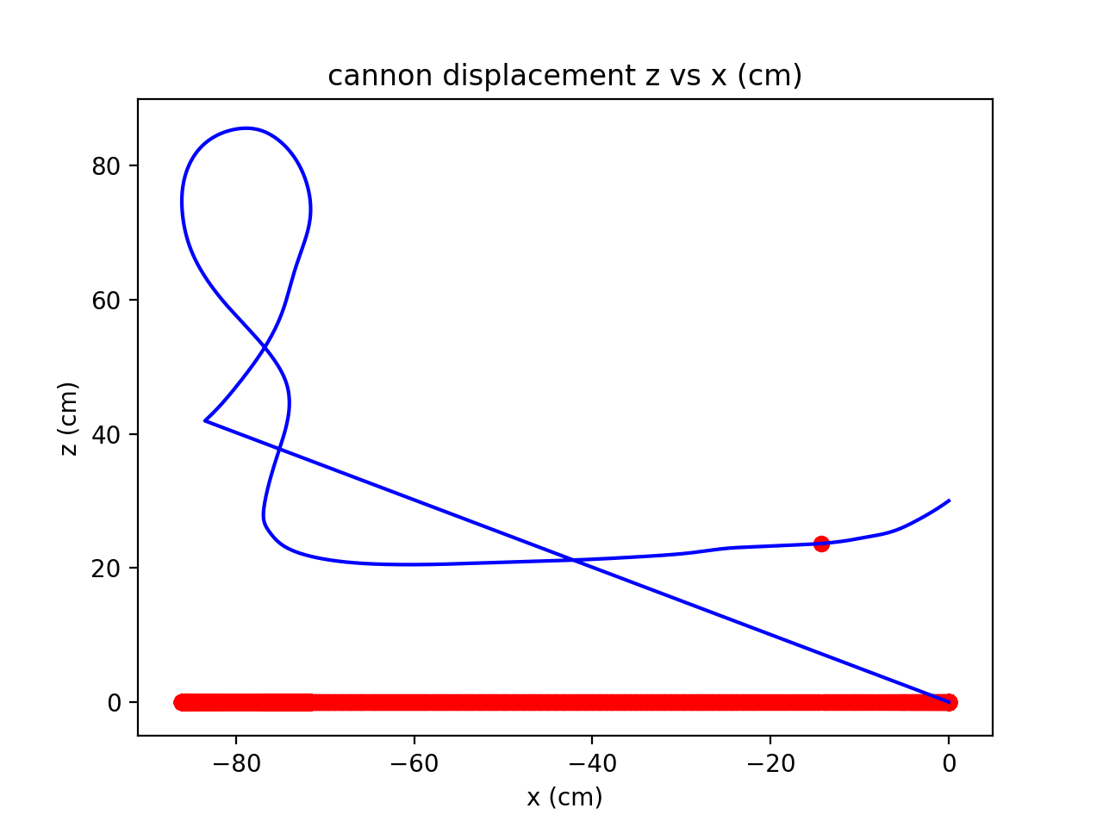
Motion Reconstruction from IMU Measurements
Iteration 3

Slide 15
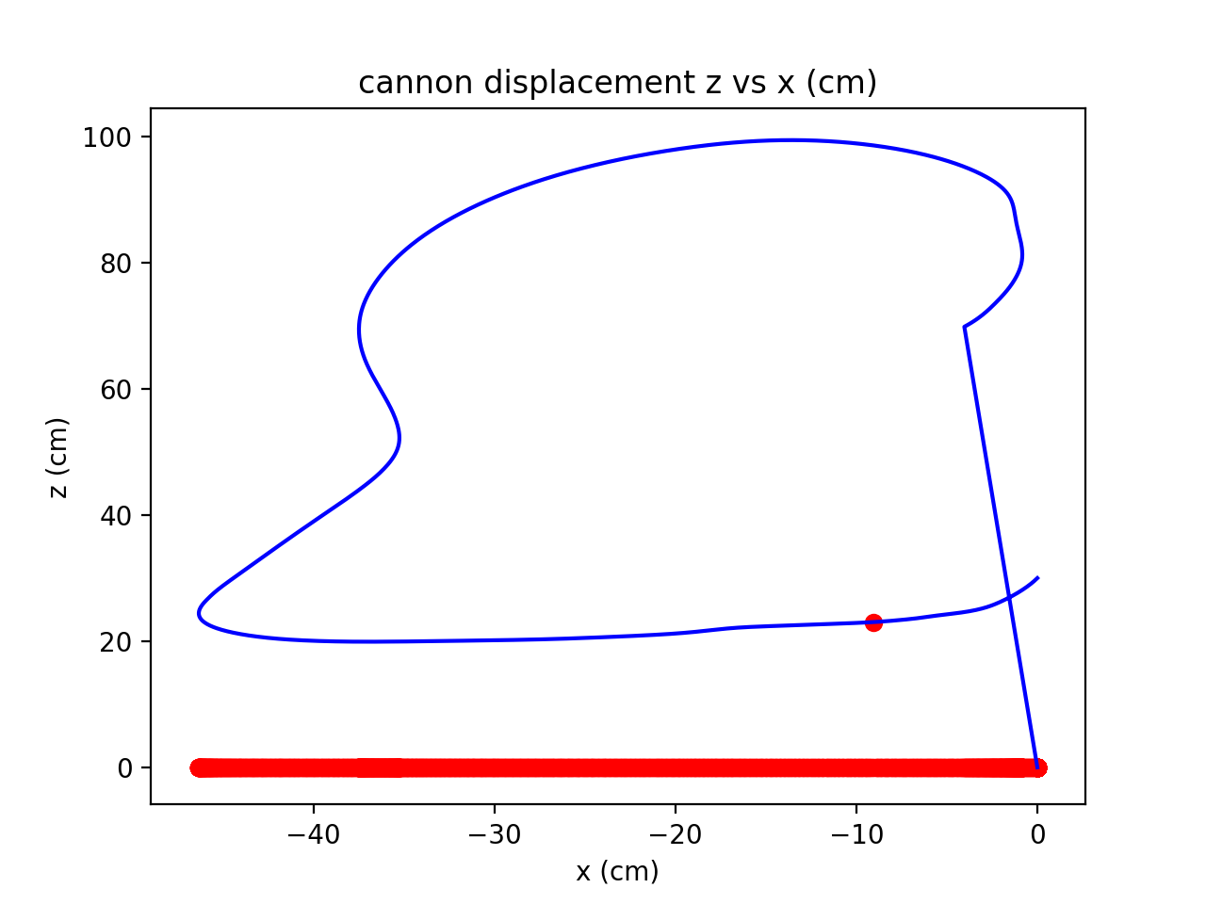
Motion Reconstruction from IMU Measurements
Iteration 5

Slide 16
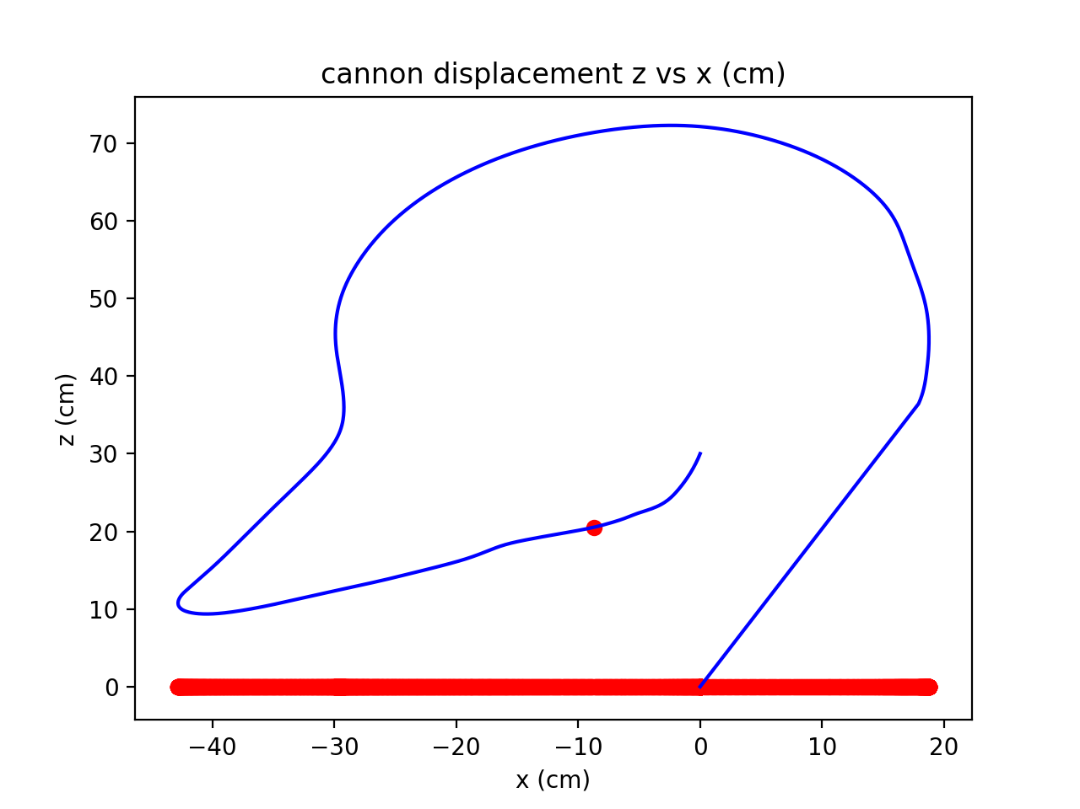
Motion Reconstruction from IMU Measurements
Iteration 6

Slide 17
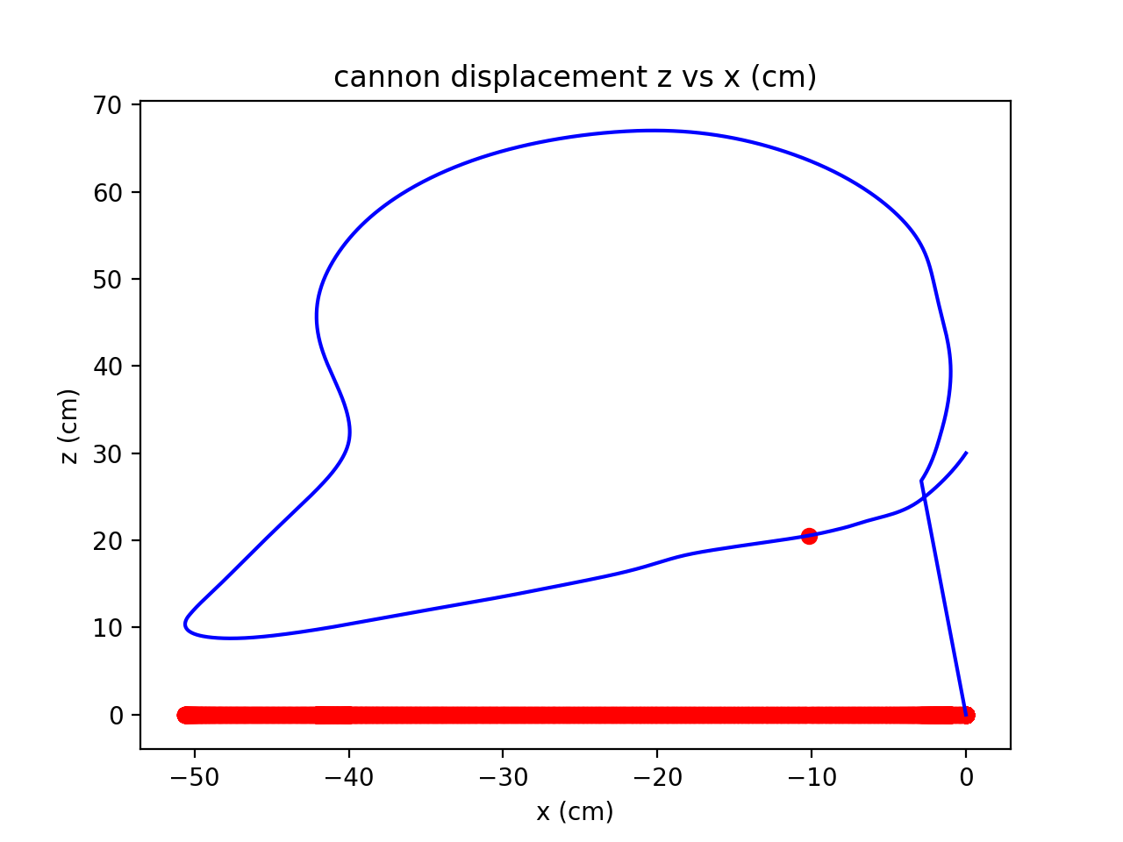
Motion Reconstruction from IMU Measurements
Iteration 8

Slide 18
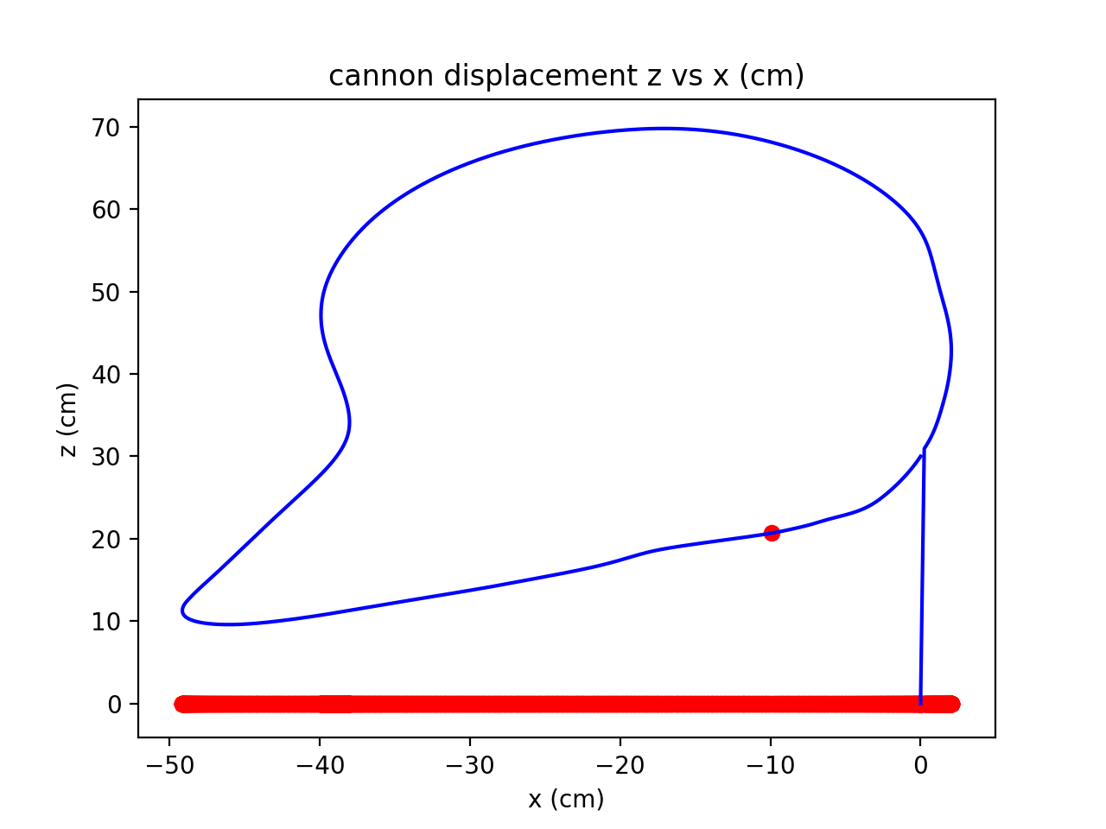
Motion Reconstruction from IMU Measurements
Iteration 10

Slide 19
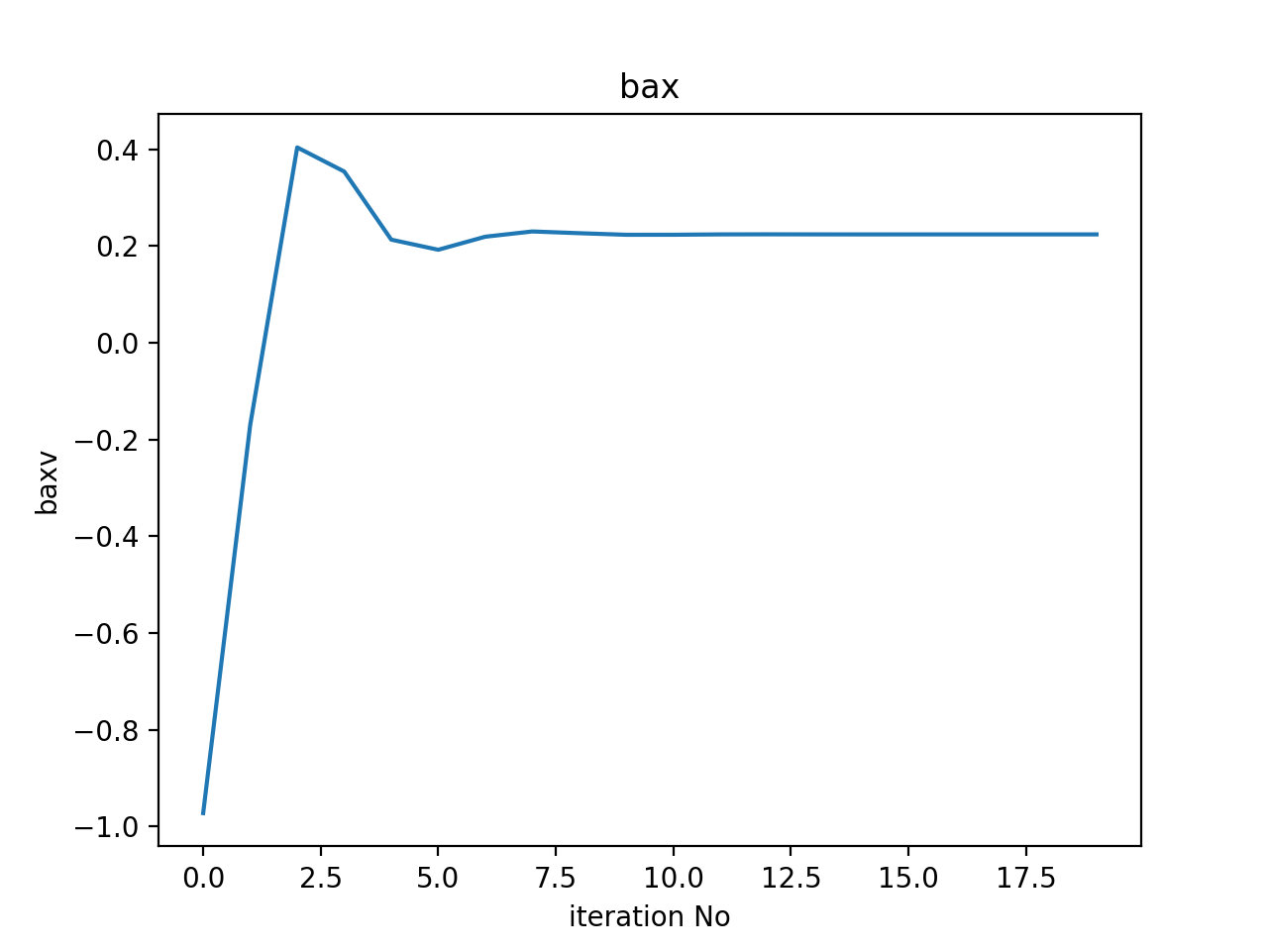
Motion Reconstruction from IMU Measurements

Slide 20
Motion Reconstruction from IMU Measurements
z vs x
Iteration 1

Slide 21
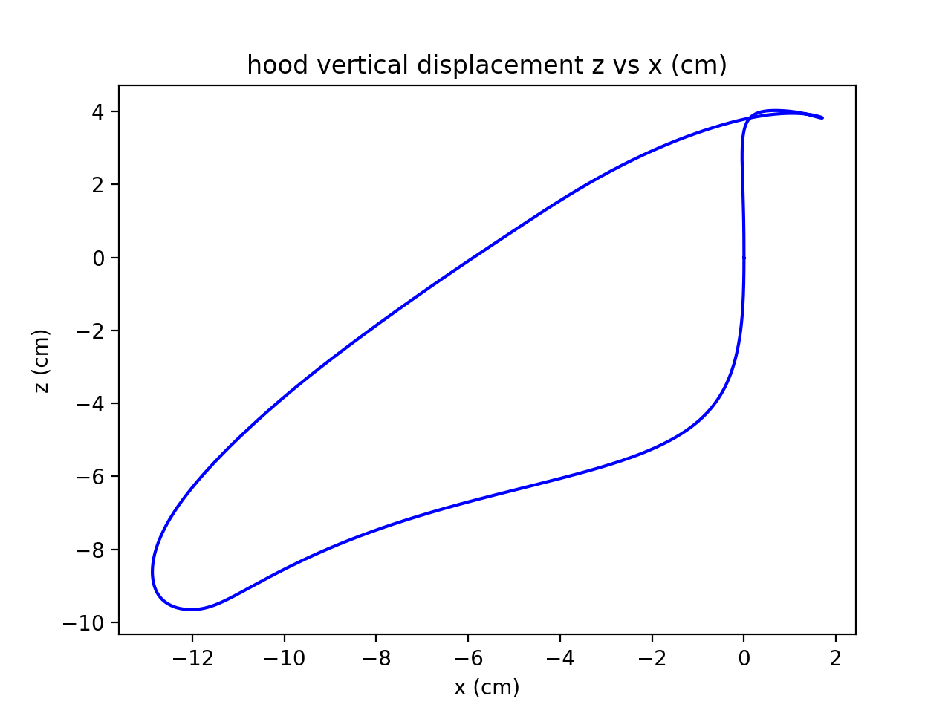
Motion Reconstruction from IMU Measurements
z vs x
Iteration 3

Slide 22

Motion Reconstruction from IMU Measurements
z vs x
Iteration 5

Slide 23
Motion Reconstruction from IMU Measurements
z vs x
Iteration 10

Slide 24
Motion Reconstruction from IMU Measurements
z vs x
Iteration 5

Slide 25
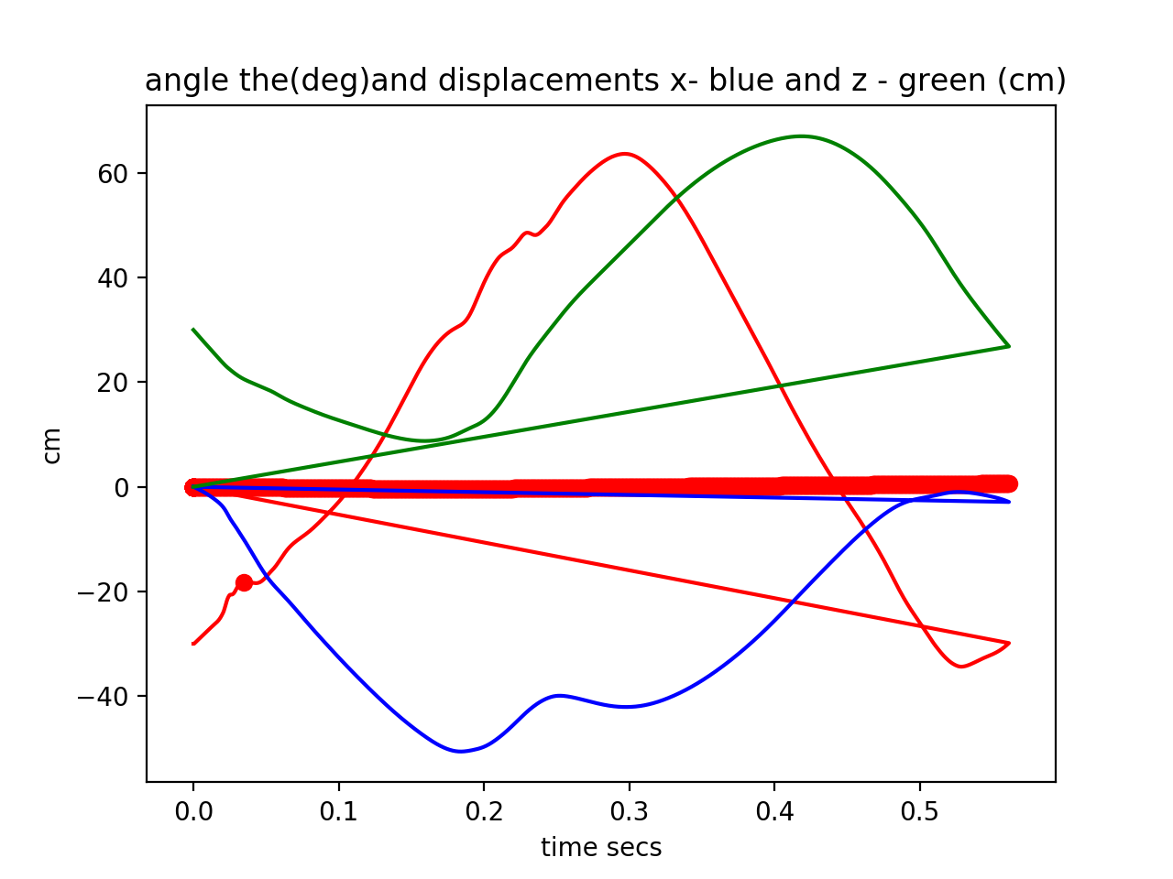
Motion Reconstruction from IMU Measurements
x,z and Theta vs. time ( Cannon)

Slide 26
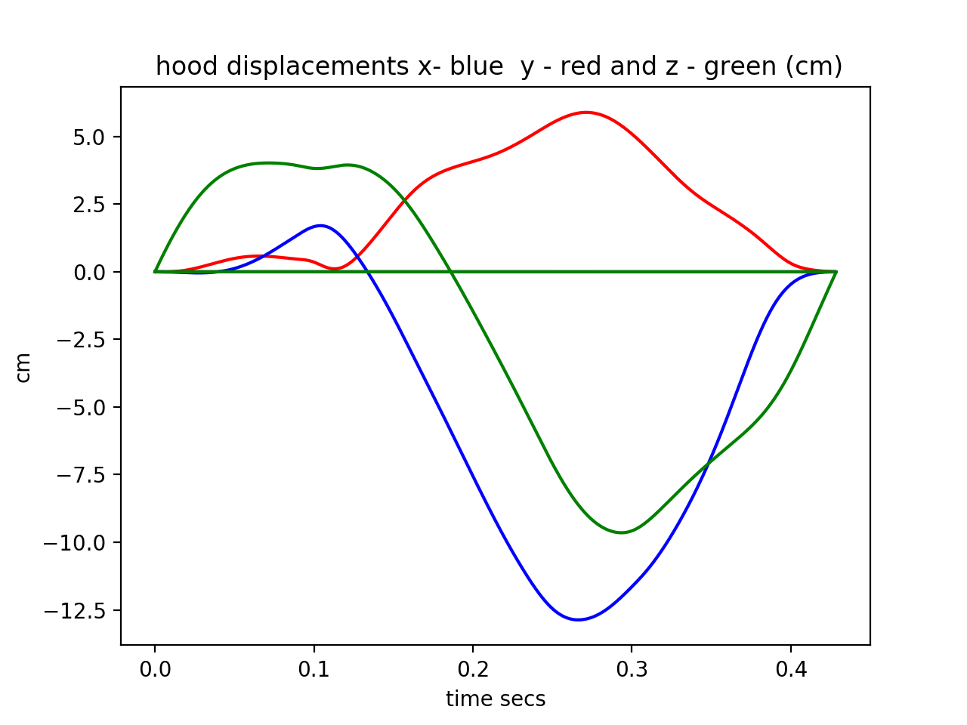
Motion Reconstruction from IMU Measurements
x,z and Theta vs. time (hood)

Slide 27
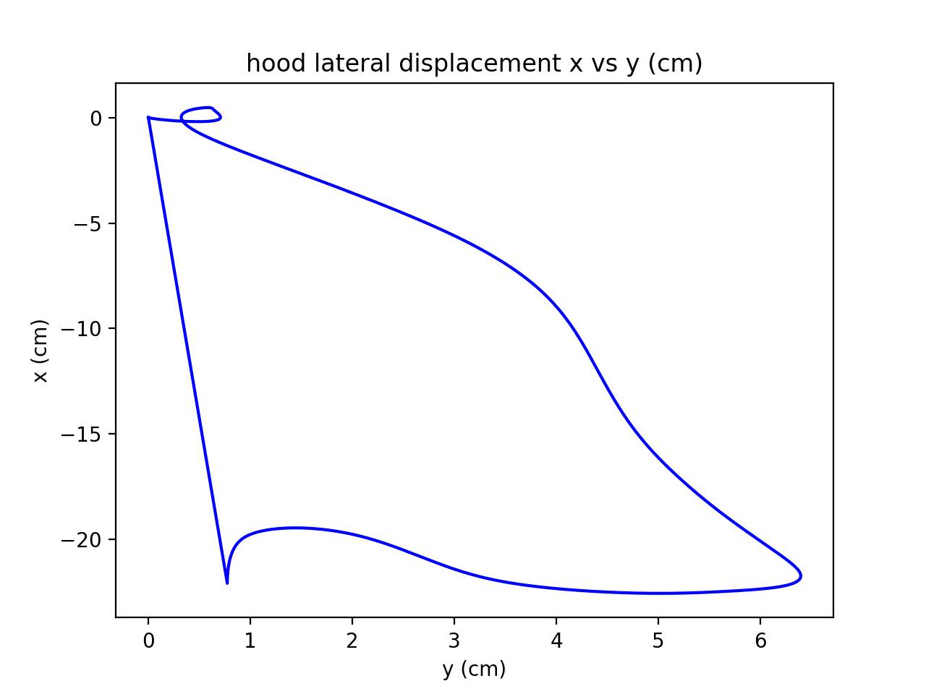
Motion Reconstruction from IMU Measurements
x vs. y
Iteration 1

Slide 28
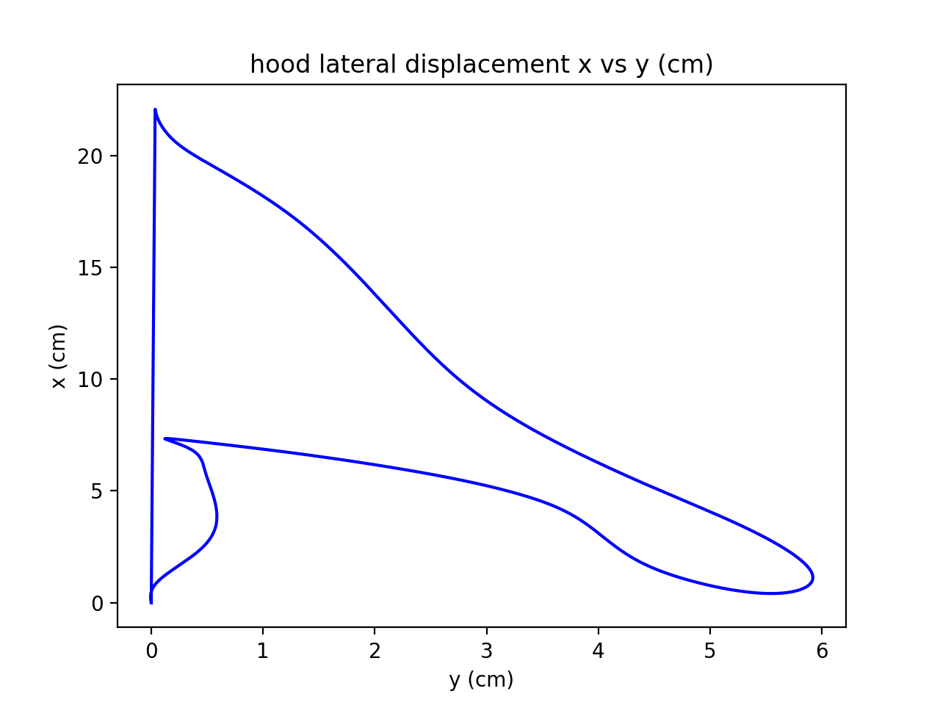
Motion Reconstruction from IMU Measurements
z vs x
Iteration 2

Slide 29
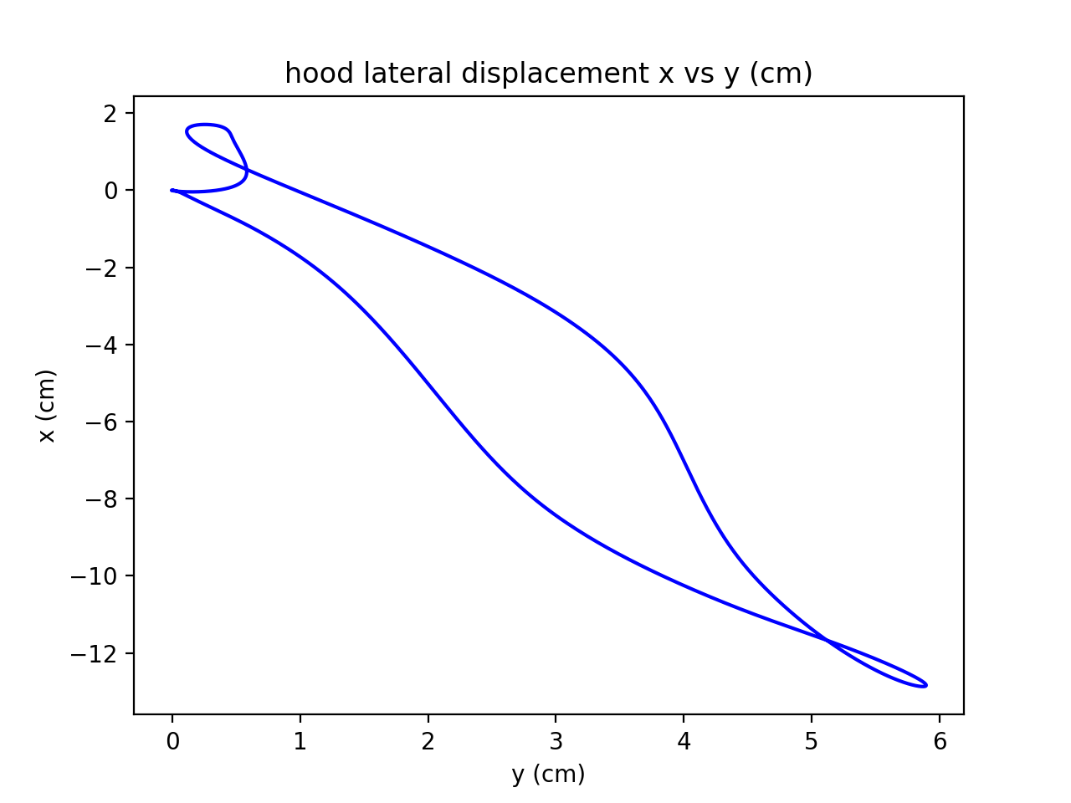
Motion Reconstruction from IMU Measurements
x vs y
Iteration 5

